Slide 1

CAPSTONE PROJECT
keylogger application capable of recording keyboard inputs in real-time.
Presented By:
Student Name- jayadhasan A
College Name- Kings Engineering College
Department- Artificial Intelligence And Data Science

Slide 2
OUTLINE
Problem Statement
Proposed System/Solution
System Development Approach
Algorithm & Deployment
Result (Output Image)
Conclusion
Future Scope
References

Slide 3
Problem Statement
Problem Statement: In today's digital age, where cybersecurity threats loom large, one of the significant concerns is the proliferation of keyloggers, stealthy software tools designed to monitor and record keystrokes on a user's computer without their knowledge. Keyloggers pose a severe threat to individuals and organizations as they can capture sensitive information such as passwords, credit card details, and other personal data, leading to identity theft, financial loss, and privacy breaches.

Slide 4
Proposed Solution
The proposed solution is to develop a keylogger application using Python, which will allow users to monitor keyboard activities in real-time. Here's a breakdown of the proposed solution:
Graphical User Interface (GUI): The application will utilize the Tkinter library, which is a standard GUI toolkit in Python, to create a user-friendly interface. The GUI will include buttons for starting and stopping the keylogger, along with a label to display the status of the keylogger (e.g., running or stopped). This makes it easy for users to interact with the application.
Keyboard Event Capture: The pynput library will be employed to capture keyboard events such as key press, hold, and release. This library allows for monitoring and controlling input devices in Python. By listening to these events, the keylogger will be able to record all keystrokes made by the user.
Data Logging: The logged keystrokes will be stored in two formats:
Text File ('key_log.txt'): The raw keystrokes will be logged into a text file for easy access and viewing.
JSON File ('key_log.json'): The keystrokes will also be logged into a JSON file in a structured format. JSON (JavaScript Object Notation) is a lightweight data interchange format that is easy for both humans and machines to read and write.
Start and Stop Functions: The application will have functions to start and stop the keylogger. When the user clicks the "Start" button, the keylogger will begin capturing keyboard events. Conversely, clicking the "Stop" button will halt the keylogger and stop recording keystrokes.
Deployment: Once the application is developed, it can be deployed for usage on various platforms, including Windows, macOS, and Linux.

Slide 5
System Approach
The "System Approach" section outlines the overall strategy and methodology for developing and implementing the rental bike prediction system. Here's a suggested structure for this section:
Tkinter: Used for creating the graphical user interface (GUI) of the application.
pynput: Employed to capture keyboard events such as key press, hold, and release.
JSON: Utilized for storing the logged keystrokes in a structured format.

Slide 6
Algorithm & Deployment
Algorithm Selection: For this keylogger application, the primary algorithmic component involves capturing keyboard events in real-time. This is achieved using the pynput library in Python, which provides functionalities for monitoring and controlling input devices. Specifically, the Listener class from pynput is utilized to capture key press, hold, and release events. By selecting this library, we ensure efficient and accurate monitoring of keyboard activities without the need for complex algorithms.
Data Input: In the context of a keylogger, the data input is the stream of keyboard events generated by the user. These events include pressing keys, holding them down, and releasing them. The pynput library captures this input data by listening to the keyboard at the operating system level. Each keyboard event is then processed by the application in real-time.
Training Process: Since this keylogger application does not involve machine learning or predictive modeling, there is no explicit training process. Instead, the application directly captures and logs keyboard events as they occur. Therefore, there is no need for training data or a training process in this context.
Prediction Process: Similarly, since there is no predictive modeling involved, there is no prediction process in this keylogger application. The application does not make predictions or decisions based on the captured keyboard events. Instead, it simply records and logs these events in real-time for later review or analysis.
Deployment: Once the keylogger application is developed, it can be deployed for usage on various platforms. Deployment involves packaging the application and making it available for installation and execution by end-users. This can be achieved by creating executable files for different operating systems or distributing the source code along with installation instructions. Additionally, considerations for security and privacy should be taken into account during deployment to ensure that the application is used responsibly and ethically.

Slide 7
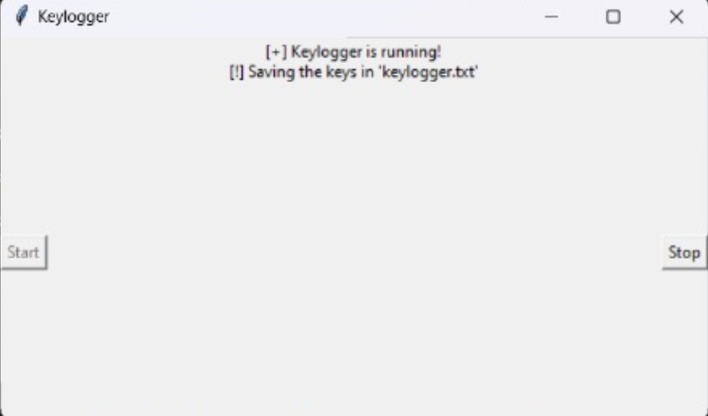
Result
The output image showcases the GUI interface with buttons for starting and stopping the keylogger, along with a label indicating the status of the keylogger

Slide 8
Conclusion
The keylogger application successfully captures keyboard inputs in real-time, providing users with a tool for monitoring keyboard activities. It offers a simple and intuitive interface for ease of use.

Slide 9
Future scope
Enhance logging capabilities by capturing additional information such as timestamps and application context.
Implement encryption for securing the logged data to ensure privacy.
Integrate remote monitoring and reporting features for surveillance purposes.
Explore compatibility with multiple operating systems and devices for broader usage.
Conduct further testing and optimization to improve performance and reliability.

Slide 10
References
Documentation of Python libraries used (Tkinter, Pynput).
Online tutorials and forums for GUI development and keyboard monitoring in Python.
Official Python documentation for file handling and JSON serialization.

Slide 11
THANK YOU

